Slide 1

Smart Tourism Automation Platform using AI & n8n
AI /ML
AI & AUTOMATION
TRAVEL TECHNOLOGY

Slide 2


Project Overview
Smart Tourism Automation Platform is an AI-powered automation system built using n8n to simplify common travel-related tasks.
What the system does
- Collects customer travel preferences
- Generates personalized travel recommendations
- Manages booking and itinerary information
- Sends weather-based travel alerts
- Analyzes customer feedback using AI
Core Idea
Connect AI + Automation + Travel Services into one streamlined workflow.
Platform: n8n | AI: OpenAI | Services: Google Sheets, Gmail, Google Calendar & Weather API

Slide 3
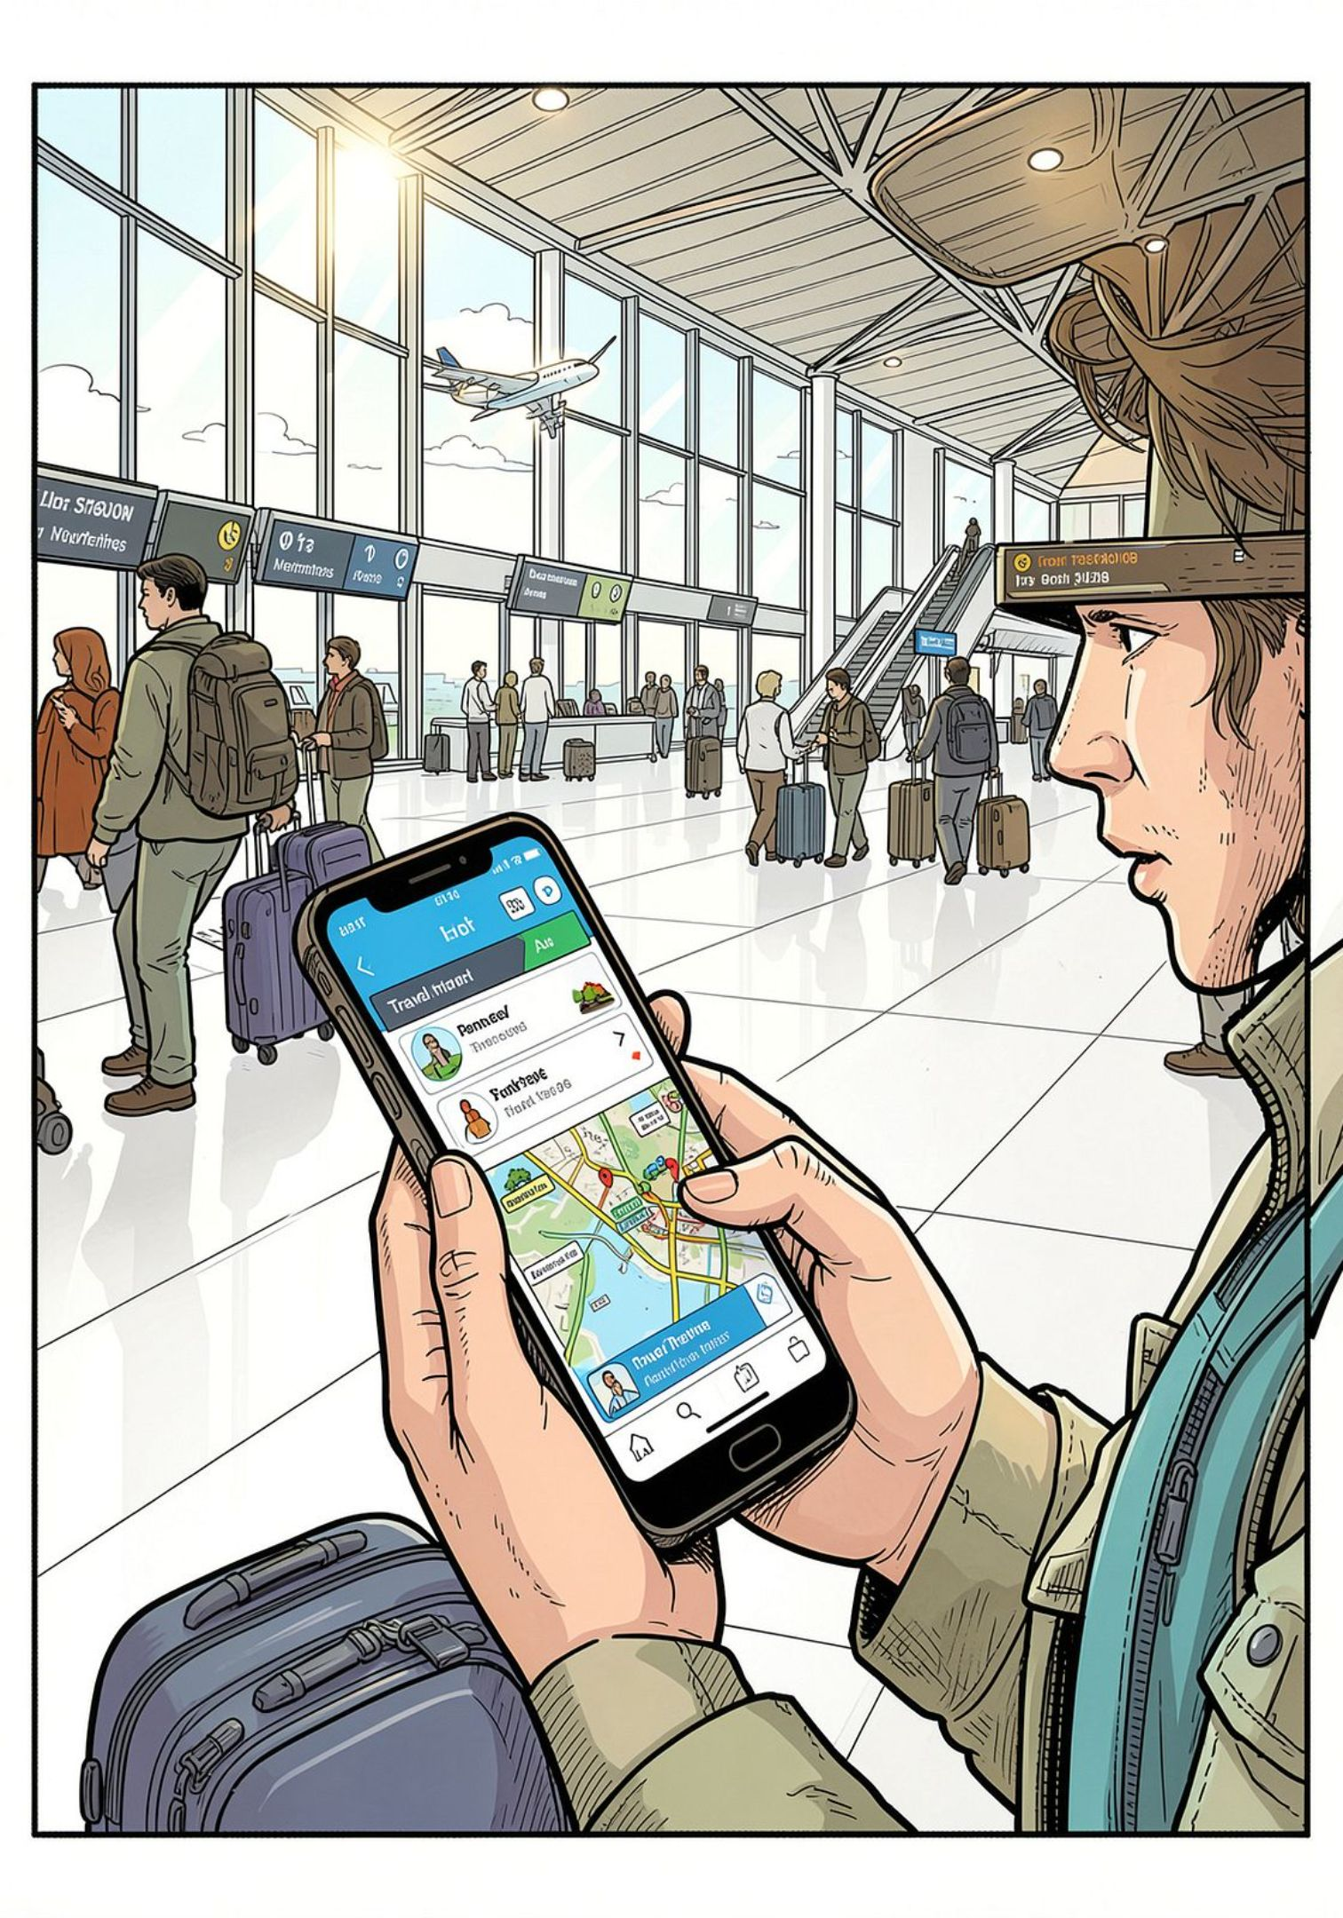

Introduction
What is the Smart Tourism Automation Platform?
An intelligent system that automates end-to-end travel planning — from registration and AI-powered recommendations to booking, itinerary generation, real-time alerts, and post-trip feedback collection.
Why Travel Automation is Useful
Manual travel planning is time-consuming and error-prone. Automation reduces human effort, ensures consistency, delivers personalised experiences, and keeps travellers informed at every stage of their journey.
Core Idea
Combine AI (OpenAI) for smart decision-making with n8n for workflow orchestration — creating a seamless, automated tourism experience.

Slide 4
Problem Statement & Objectives
Travel Planning Pain Points
Main Objectives of the Project
Overwhelming amount of information to research manually
No personalised recommendations based on preferences
Fragmented tools for booking, scheduling, and alerts
Lack of real-time travel updates and weather notifications
No structured feedback loop to improve future trips
Automate customer registration and data capture via webhooks
Generate AI-powered personalised travel recommendations
Auto-create itineraries and send booking confirmations
Deliver real-time travel alerts (weather, reminders)
Collect and analyse post-trip feedback automatically

Slide 5





Proposed Solution
How AI + n8n automates travel planning, booking, alerts and feedback.
Customer Registration
AI Recommendation
Booking & Itinerary
Webhook captures user preferences, destination interest, budget, and travel dates automatically into Google Sheets.
OpenAI Agent analyses user data and suggests personalised destinations, activities, and travel tips.
n8n auto-generates a day-wise itinerary, sends Gmail confirmations, and creates Google Calendar events.
Travel Alerts
Feedback & Analytics
Weather API triggers automated alerts for adverse conditions; reminder emails are sent before departure.
Post-trip feedback forms are sent via Gmail; responses are logged in Google Sheets for analytics.

Slide 6
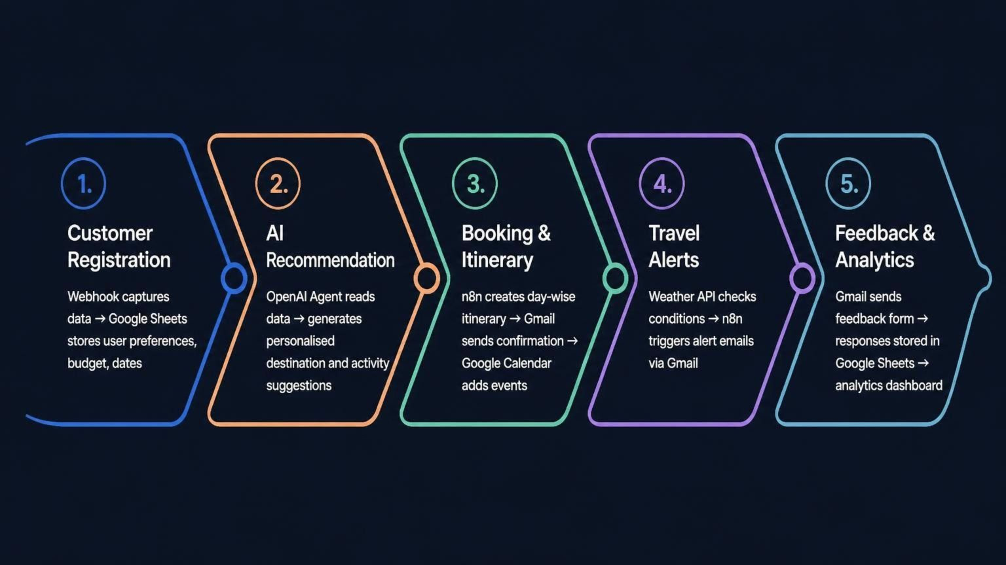
Detailed System Workflow
The unified architecture covering all 5 workflows with key integrations: Webhooks, AI Agent/OpenAI, Google Sheets, Gmail, Google Calendar, and Weather API.
The diagram above illustrates the end-to-end automated flow — from initial user registration through AI-powered recommendations, booking and itinerary creation, real-time travel alerts, and finally post-trip feedback collection and analytics — all orchestrated by n8n with integrated services.

Slide 7
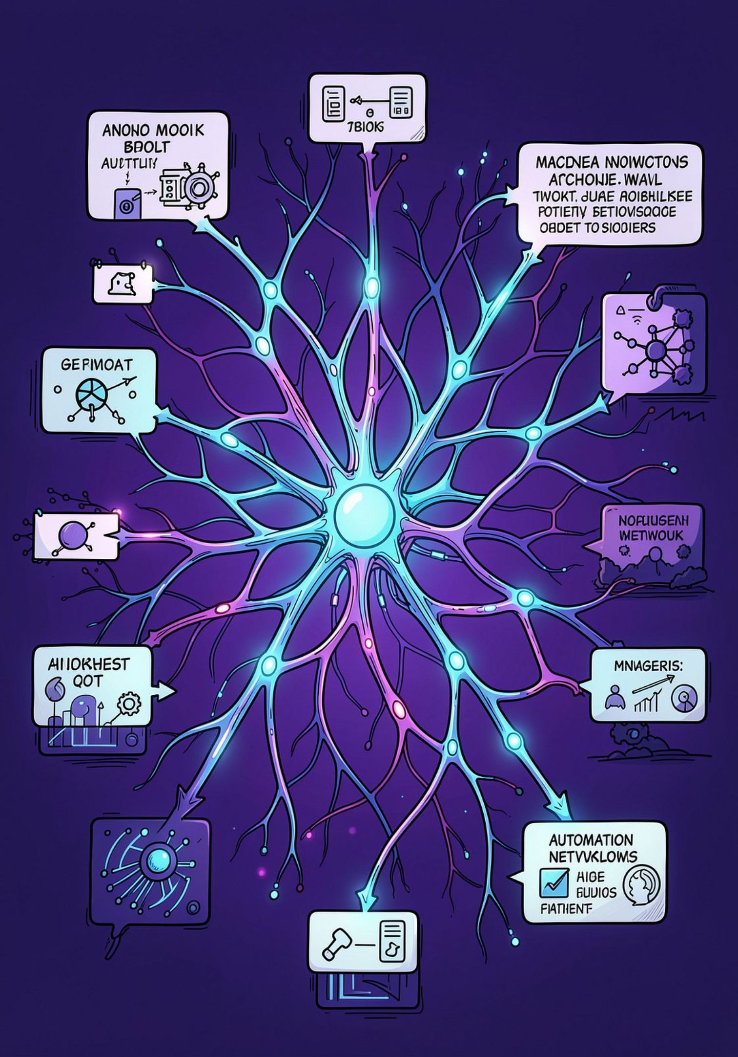





AI & Automation
AI Agent (OpenAI)
The OpenAI Agent acts as the intelligent core — it reads user preferences from Google Sheets, understands natural language queries, and generates context-aware travel recommendations, itinerary descriptions, and personalised tips.
n8n Automation
n8n orchestrates all workflows without manual intervention. It connects webhooks, AI agents, APIs, and Google services into seamless automated pipelines — triggering actions based on events and conditions.
Event-Driven Triggers
Every workflow is triggered by specific events — a new form submission, a scheduled time, or an API response — ensuring the system reacts in real time without human input.

Slide 8







Technologies & Integrations
n8n
Webhooks
OpenAI
Open-source workflow automation platform that connects all services and orchestrates the 5 core workflows.
Capture real-time user inputs from registration forms and trigger downstream automation workflows instantly.
Provides the AI Agent for generating personalised travel recommendations, itineraries, and smart suggestions.
Google Sheets
Gmail
Google Calendar
Stores user registration data, preferences, booking details, and feedback responses in structured tables.
Sends automated booking confirmations, travel alerts, reminders, and post-trip feedback request emails.
Auto-creates calendar events for each day of the itinerary, keeping travellers organised and on schedule.
Weather API
Fetches real-time weather data for destinations and triggers automated alerts for adverse conditions.

Slide 9

Implementation & Results
1
What Was Implemented
All 5 workflows were built and tested in n8n — Customer Registration (webhook → Google Sheets), AI Recommendation (OpenAI Agent), Booking & Itinerary (Gmail + Google Calendar), Travel Alerts (Weather API + Gmail), and Feedback & Analytics (Gmail + Sheets).
2
Main Outputs & Results
The system successfully auto-generated personalised itineraries, sent booking confirmation emails, created calendar events, delivered weather-based alerts, and collected structured feedback — all without manual steps.
3
Key Achievement
Demonstrated a fully automated, end-to-end smart tourism pipeline using free-tier tools — proving that intelligent travel automation is achievable with accessible technology.

Slide 10
Future Scope
🛫 Live Booking APIs
🌍 More Travel APIs
Integrate real flight, hotel, and transport booking APIs (Skyscanner, Amadeus) for end-to-end reservations.
Add APIs for attractions, local transport, currency conversion, and visa information for richer recommendations.
📊 Better Analytics
🔁 Error Handling / Retry
Build a visual analytics dashboard to track user behaviour, popular destinations, and feedback trends.
Implement robust error handling and automatic retry logic in n8n workflows for production reliability.
✅ Human Approval
🗺️ More Destinations
Add a manual approval step before final booking confirmation for user control and safety.
Expand the AI knowledge base to cover more global destinations, languages, and cultural contexts.

Slide 11



Conclusion
Project Summary
The Smart Tourism Automation Platform successfully demonstrates how AI (OpenAI) and workflow automation (n8n) can transform the travel planning experience — making it faster, smarter, and fully automated.
Key Benefits
Eliminates manual effort in travel planning and booking
Delivers personalised, AI-driven recommendations
Keeps travellers informed with real-time alerts
Creates a closed feedback loop for continuous improvement
Overall Outcome
This project proves that a fully automated, intelligent tourism platform is achievable using accessible, open-source tools — paving the way for smarter, more efficient travel experiences in the future.

